Slide 1

File I/O

Slide 2
Topics
File Input and Output
Character Streams
BufferedReader and BufferedWriter
File Management
Random Access Files
Object Serialization
Java Properties file

Slide 3
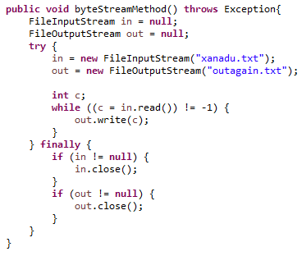
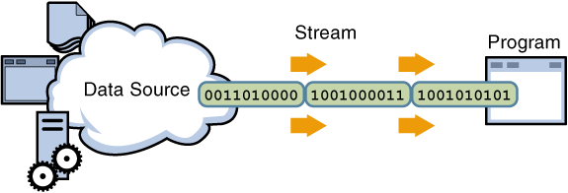
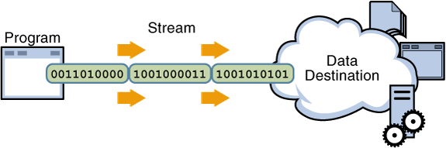
File I/O
The Java API has many utilities for File I/O
Classes associated with input inherit from InputStream
Classes associated with output inherit from OutputStream
FileInputStream reads raw bytes from a file
FileOutputStream writes raw bytes to a file
Always close resources after using them

Slide 4
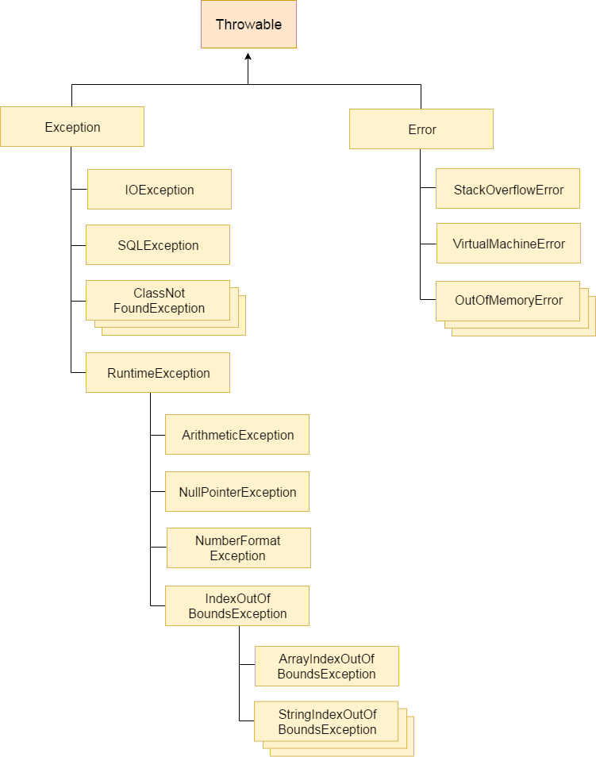

Slide 5
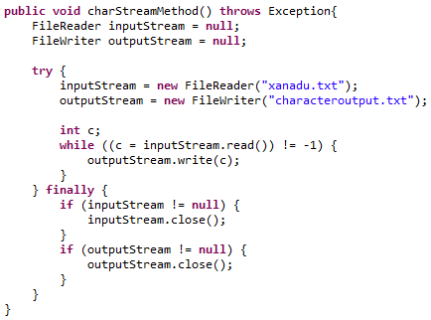
Character Streams
FileReader lets you read characters from a file
FileWriter lets you write characters to a file
This time actual characters are read/written
Always close resources after using them

Slide 6
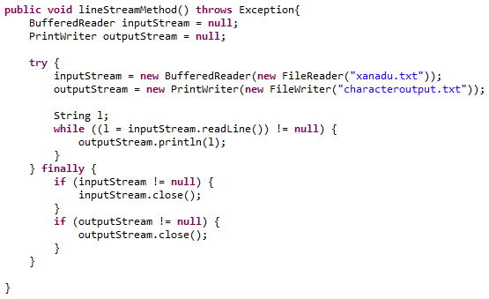
Line-Oriented I/O
Character files can be read line-by-line
Line is read until it reaches:
A new line
A carriage feed
Wrap FileReader into BufferedReader
Wrap FileWriter in PrintWriter
Always close resources after using them

Slide 7
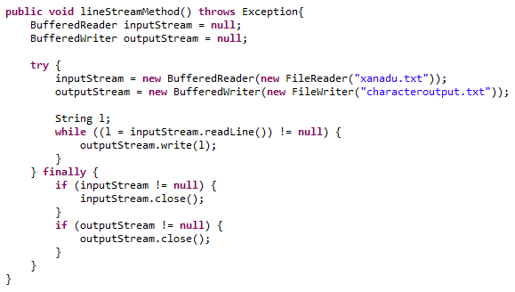
Buffered Reader and Writer
For faster performance:
Use Buffered Reader and Writer
Wrap FileReader into BufferedReader
Wrap FileWriter in BufferedWriter
Always close resources after using them

Slide 8
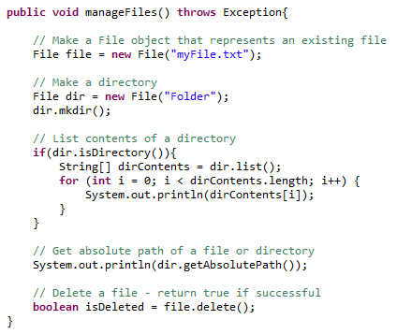
File Management
Where are the files? What about folders?
The File Object can help work with files
Methods for making folders
Listing directory contents
Finding absolute path
Deleting files

Slide 9
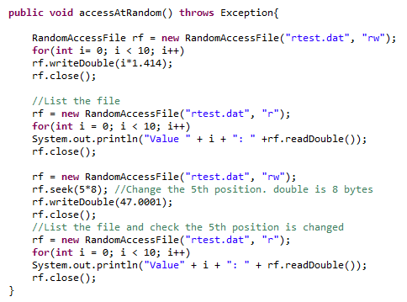
Random Access Files
Random access files permit access to a file's contents:
Non-sequential order
Random order
To access a file randomly:
Open the file
Seek a particular location
Read from or write to that file
A file can be Read-Only “r”
Or Read-Write “rw”
Always close resources after using them

Slide 10


Serialization
Serialization is the process of writing the state of an object to a byte stream
Serializable
Any object which is
Passed across the network
Saved to a DAT file
Object must implement Serializable interface.
The Serializable interface defines no members
It is simply used to “mark” that class may be serialized.
Serializable is a “marker” interface
If a class is serializable, all of its subclasses are also serializable.

Slide 11
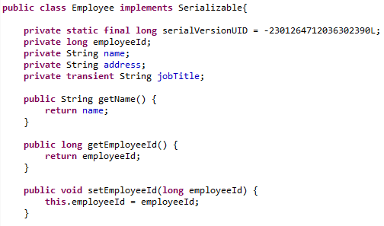
Serializable Object
Serialization transforms variables into bytes
Any transient variables will not be serialized

Slide 12
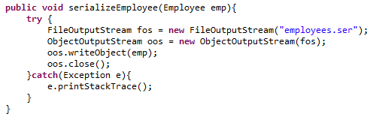
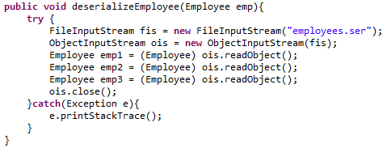
Serializing/Deserializing an Object
Serialization
Wrap a FIleOutputStream in an ObjectOutputStream
Write the Object
Always close resources after using them
Deserialization
Wrap a FIleInputStream in an ObjectInputStream
Read the Object
Cast the Object back into its original type
Always close resources after using them

Slide 13
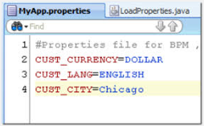
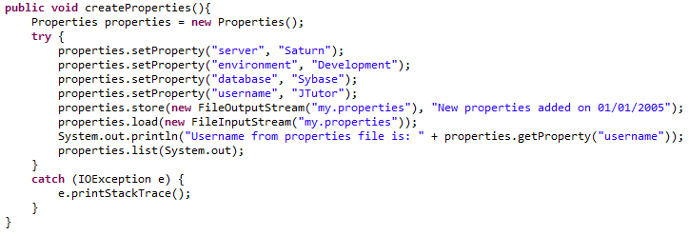
Properties Files
Create key value pairs for your applications
Set method adds a property (key, value)
Store saves a file with .properties extension
Load will load a properties file

Slide 14
Review
File Input and Output
Character Streams
BufferedReader and BufferedWriter
File Management
Random Access Files
Object Serialization
Java Properties file

Slide 15
Assignment
Consider a text file has the following colon-separated lines:
Employee id:First Name:Last Name:Role
Read the file, and parse(tokenize) the fields using StringTokenizer with delimiter(:)
While parsing the file, place the information in an object, which should have four instance variables: Employee Id, First Name, Last Name, Role.
Place these objects in a HashMap with the key as employee id and value as the object
i.e HashMap should have
Key: 01 Value : Object representing first line
Key: 02 Value: Object representing second line

